Slide 1

Current and Future
Composting Operations
Public Works Department
Environmental Quality Commission
June 11, 2015

Slide 2

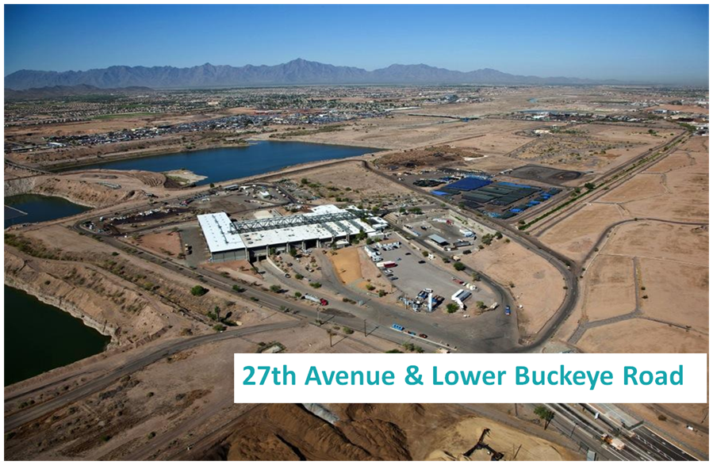
Background
Citywide 40% diversion goal by 2020
Resource Evaluation Study – 2014
Existing Mulching Operations
Pilot Food Scraps Composting Program – Implemented January 2015
New Composting Facility – late summer 2016
Partnership with Parks & ASU
Notes:
In February 2013 Mayor and Council established a citywide goal to divert 40% by the year 2020 in an effort to improve the City’s diversion rate (residential at 20%)
Completed the first phase of the resource evaluation in August 2014 and included a review of 130 garbage samples and 101 recycling samples
Conducted mulching operations through a contractor at 27th Avenue Transfer Station since 2000
Began pilot composting program at 27th Avenue Transfer Station in January 2015
Developing a Resource Innovation Campus at 27th Avenue and Lower Buckeye Roads that includes the Transfer Station, Recycling Facility, Mulching area, Composting Facility, RISN/Technology Incubator Headquarters with ASU, and Businesses/Manufacturers

Slide 3
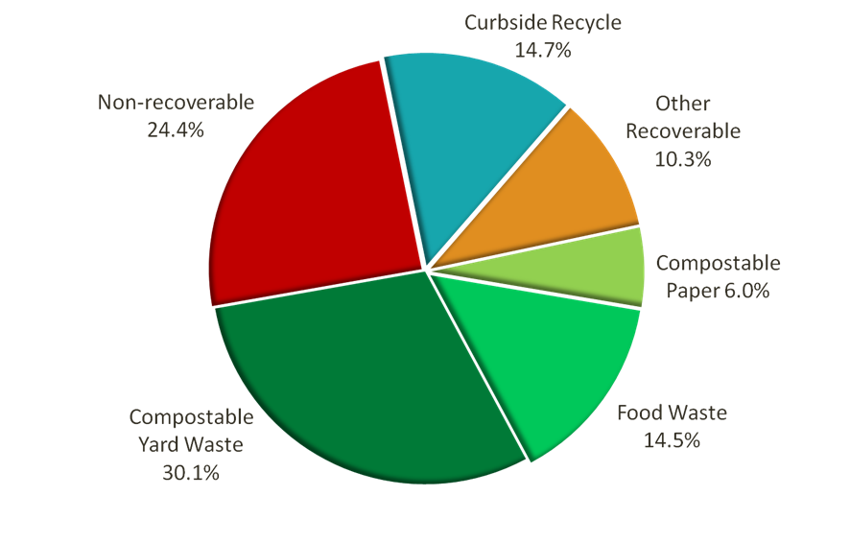
Resource Evaluation Study
Notes:
50%- Compostable - paper, plastic, yard and food waste (compostable yard waste is 30% of that or 118,000 tons; food waste is 15% or 56,500 tons)
15%-Curbside Recycling - newspapers, cardboard, plastic, recyclable glass, aluminum (57,500 tons) - 15% of what we throw away should be recycled
10%- Other Materials that CAN be recycled but not in the Phoenix program, ie. plastic grocery bags, textiles, other metals
25% - Non-Recoverable - true trash
The findings of the study showed nearly 65% of garbage sampled could be diverted from the landfill

Slide 4

Mulch vs Compost
Food Scraps
Mulch/Compost
Pilot Composting Program includes Partnerships with:
  Bashas’ (Food City)
  Aviation
  Super Bowl - Special Events
  Global Green Innovators (GGI)
  Produce distributors
  City Facilities
Mulch - yard clippings processed into chipped material
Compost – Mulch + quality food scraps, the biological decomposition of organic matter under controlled conditions

Slide 5
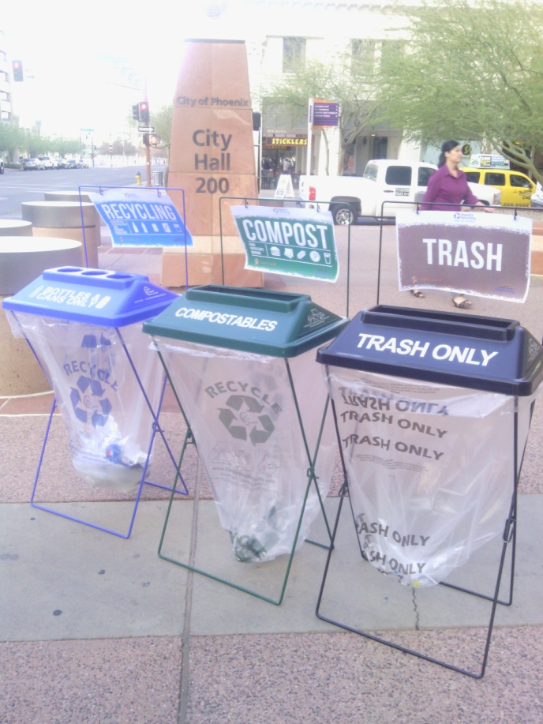
Super Bowl Central
Coordinated with The Super Bowl Host
Committee and the NFL
Containers placed at the Event
  225 recycling
  125 compost
  150 trash containers with clear bags
Notes:
In February 2013 Mayor and Council established a citywide goal to divert 40% by the year 2020 in an effort to improve the City’s diversion rate (residential at 20%)
Completed the first phase of the resource evaluation in August 2014 and included a review of 130 garbage samples and 101 recycling samples
Conducted mulching operations through a contractor at 27th Avenue Transfer Station since 2000
Began pilot composting program at 27th Avenue Transfer Station in January 2015
Developing a Resource Innovation Campus at 27th Avenue and Lower Buckeye Roads that includes the Transfer Station, Recycling Facility, Mulching area, Composting Facility, RISN/Technology Incubator Headquarters with ASU, and Businesses/Manufacturers

Slide 6
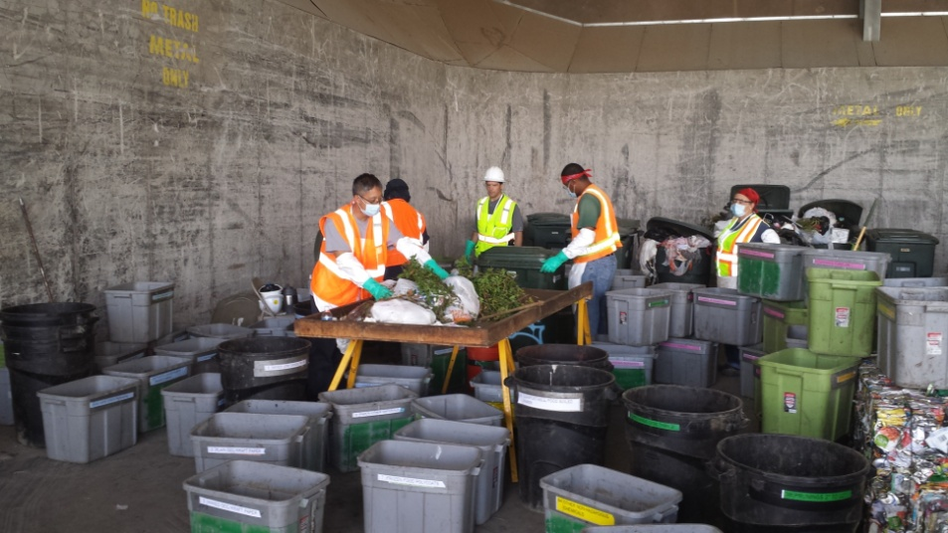
Super Bowl Sorting
73.1 Diversion
66,740 pounds sorted
  Trash 26.9%
  Organics 31.8%
  Aluminum 10.8%
  Recyclables 30.5%
Notes:
In February 2013 Mayor and Council established a citywide goal to divert 40% by the year 2020 in an effort to improve the City’s diversion rate (residential at 20%)
Completed the first phase of the resource evaluation in August 2014 and included a review of 130 garbage samples and 101 recycling samples
Conducted mulching operations through a contractor at 27th Avenue Transfer Station since 2000
Began pilot composting program at 27th Avenue Transfer Station in January 2015
Developing a Resource Innovation Campus at 27th Avenue and Lower Buckeye Roads that includes the Transfer Station, Recycling Facility, Mulching area, Composting Facility, RISN/Technology Incubator Headquarters with ASU, and Businesses/Manufacturers

Slide 7

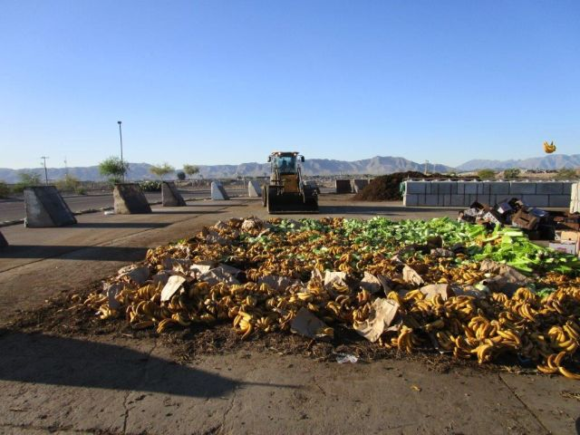
Pilot Turf Study Compost
Benefits on turf health
Funded by PWD with Parks
Beginning Fall 2015
2 year study
3-4 Park locations & Downtown
Use Parks Dept. specifications
Cost Effective – Free during initial pilot phase
Supports the Circular Economy and Landfill diversion
Helps achieve City’s 40% diversion goal by 2020
Research and expertise from ASU through PWD/ASU Partnership from the Resource Innovation and Solutions Network (RISN)

Slide 8
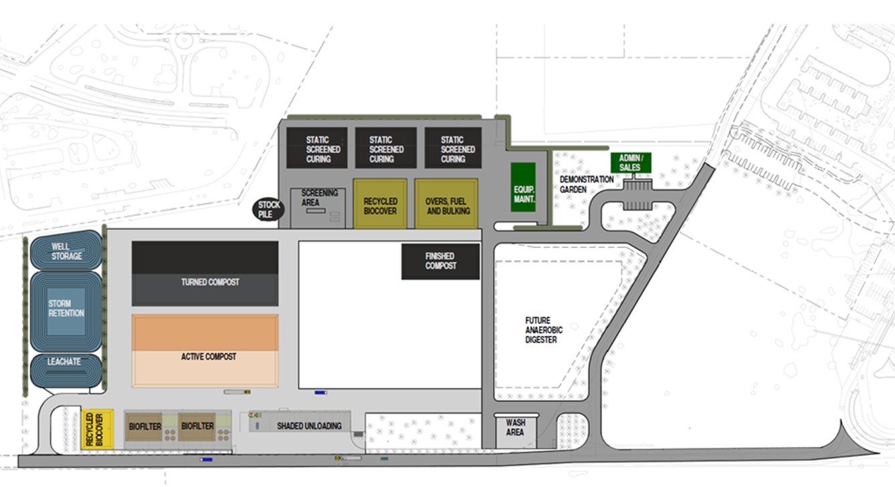
Composting Facility
Notes:
The City is designing and constructing a multiple phased composting facility with the capacity in phase 1 to process 110,000 tons of organic material per year with capacity to build out to 220,000 tons with future funding. The facility is being designed to the highest environmental standards to meet all current and future regulatory requirements.
Composting Facility expected to be completed late summer/fall 2016

Slide 9
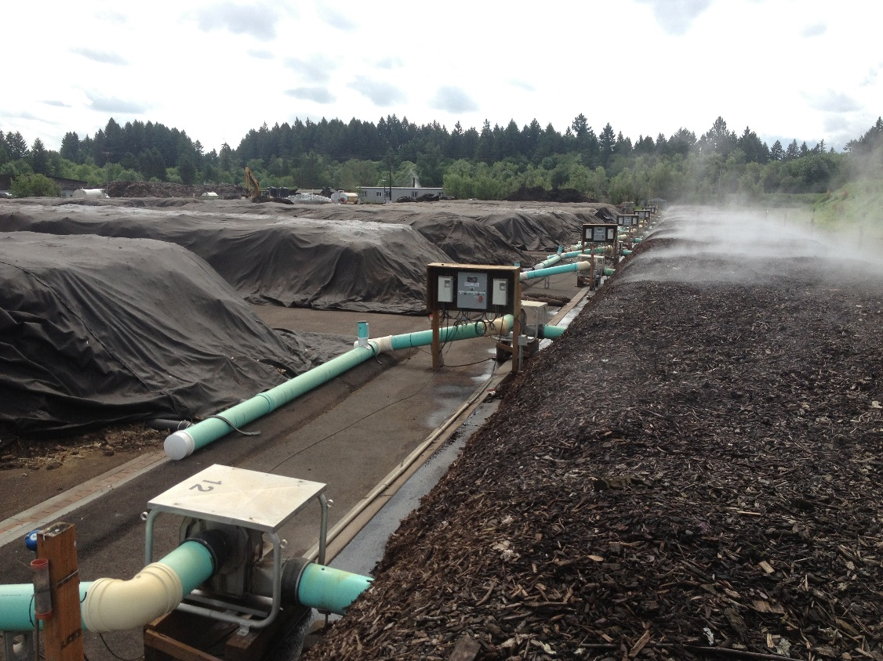
Aerated Static Piles
Elevates oxygen levels
  Oxygen depleted in less than 20 minutes
Temperature control
Reduces odor control
AIR is Most Influential Factor in compost stability*

Slide 10
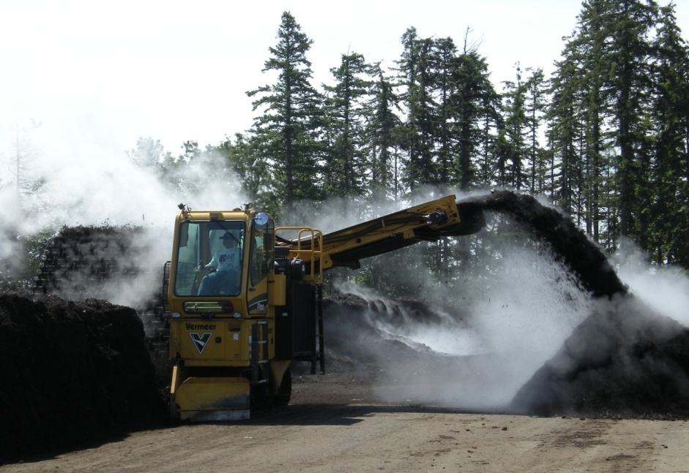
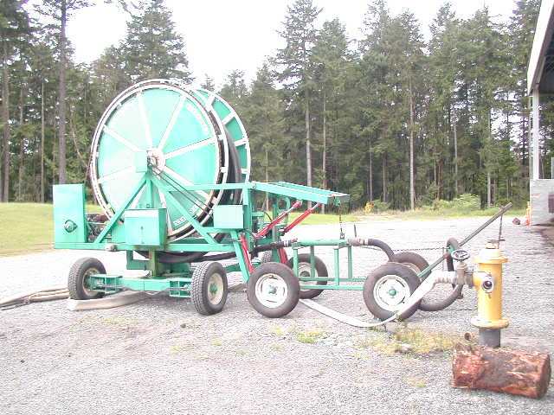
Mass Bed Turning & Irrigation
Side Discharge Turner
(turns 1,000 yd³/hr )
Irrigation Reel with hose connection to turner

Slide 11
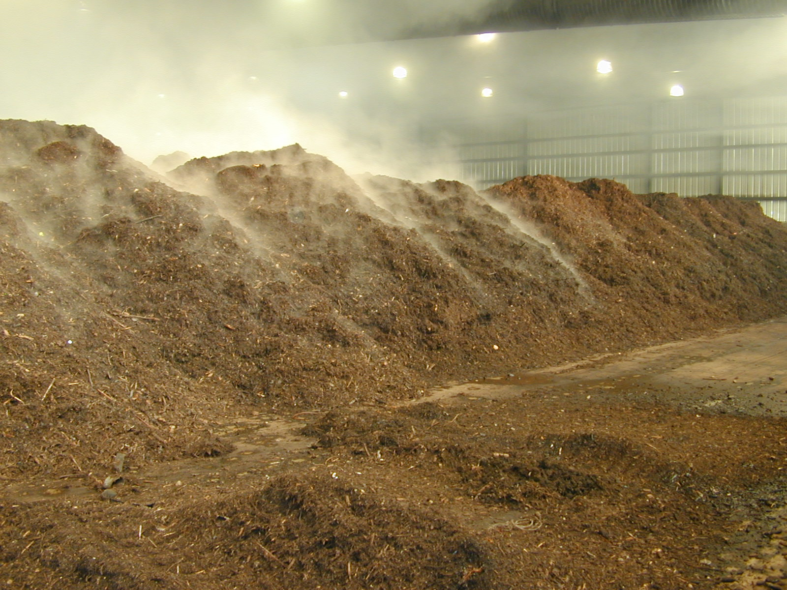
Forced Aeration Options
Positive
Negative
Reversing
Aerated Earth Pad with Reversing Aeration

Slide 12
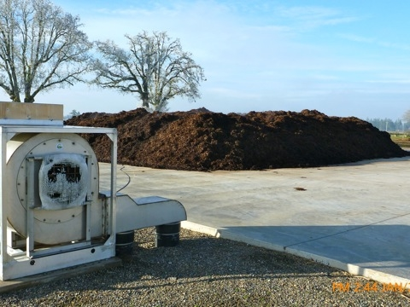
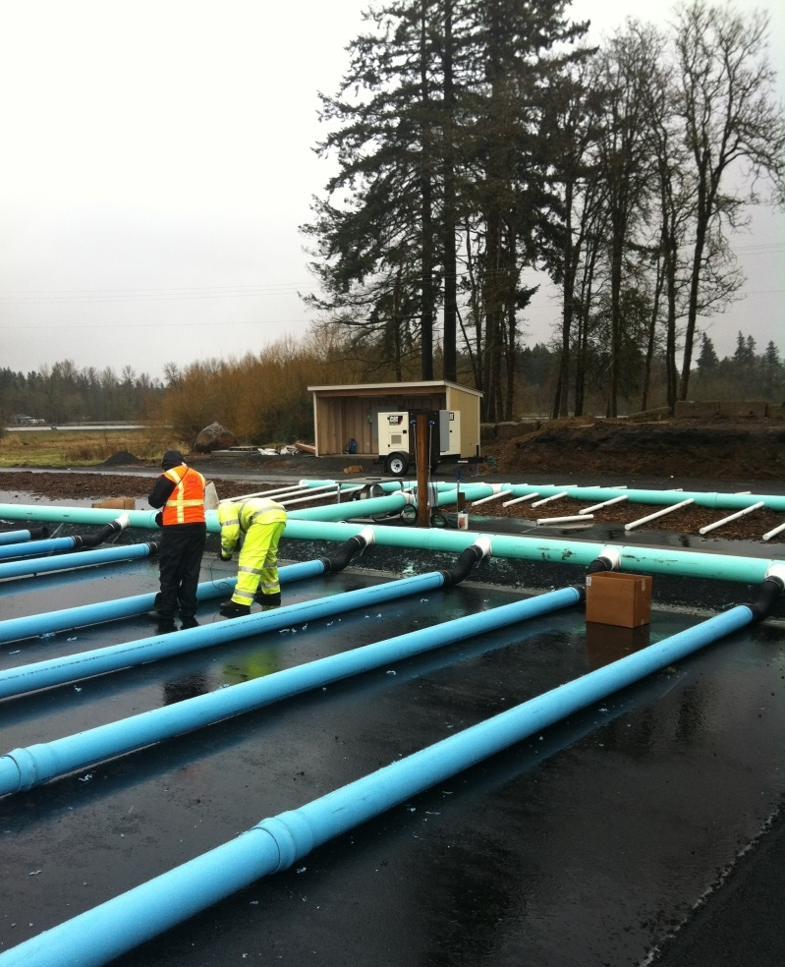
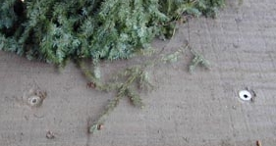
Above or Below Grade Aeration?
Below Grade Sparger System
Above Grade Piping with Biofilter

Slide 13
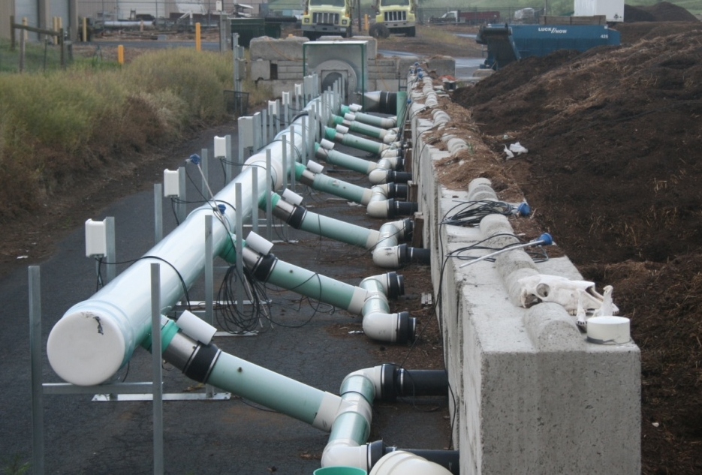
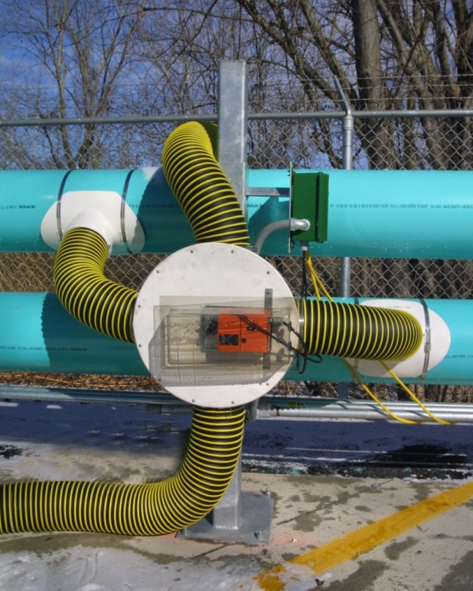
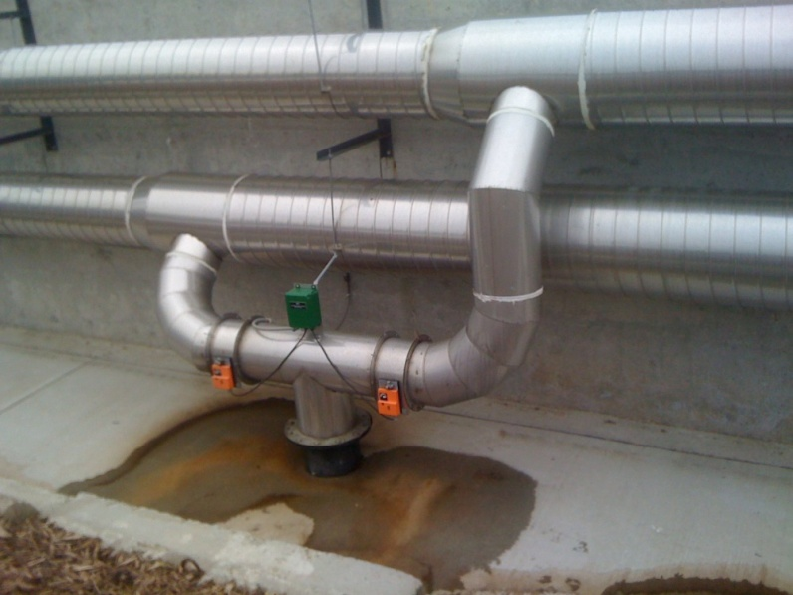
Blowers, Ducts & Dampers
Ducts sized to minimize friction losses
Negative aeration manifold
Dual damper system for open bunkers
Rotary damper for reversing aeration

Slide 14
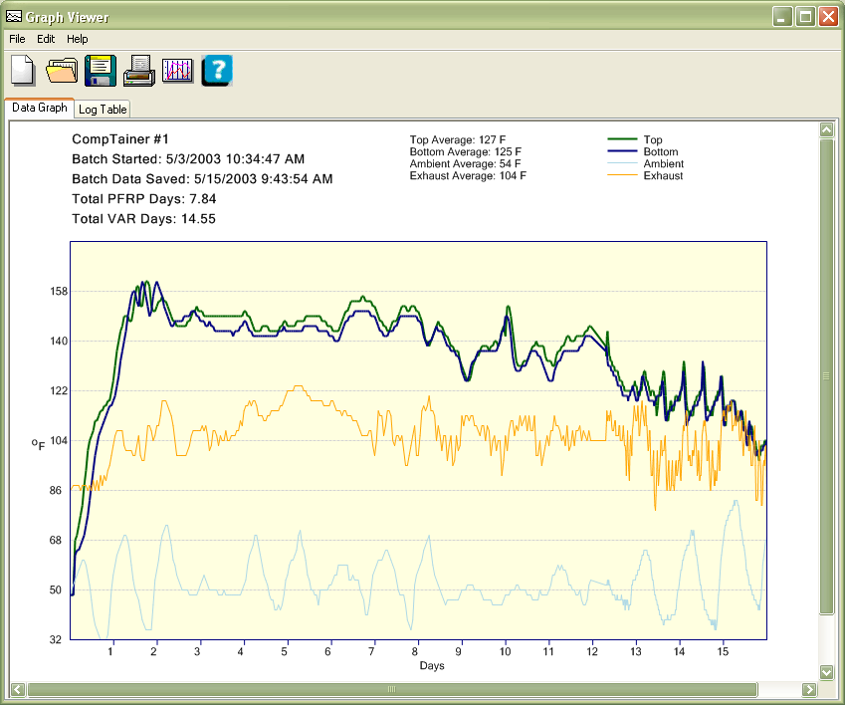
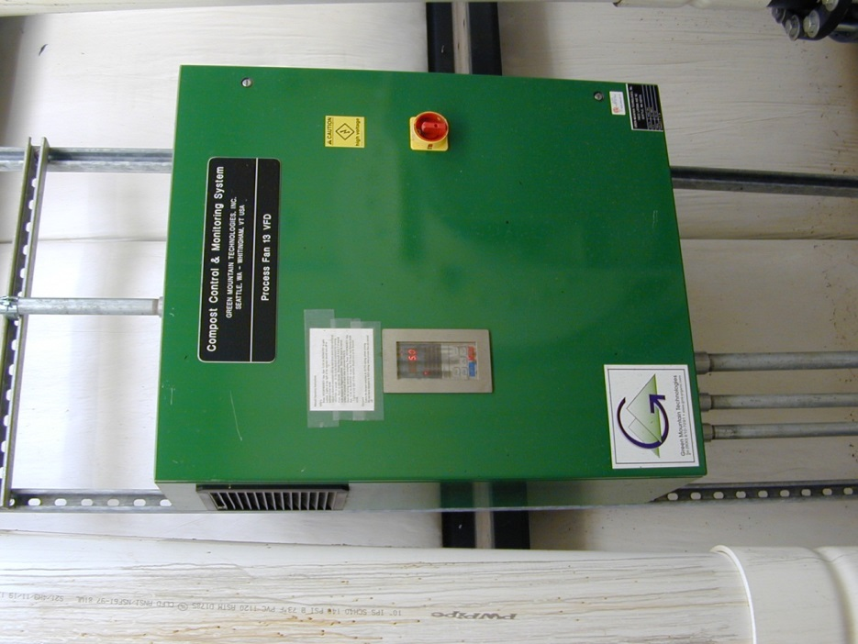
Advanced System Controls
Aeration Control System & VFDs
Variable Frequency Drives
Time/Temp Graph
Notes:
Marcelo – close/transition into sustainability – 1 minute

